Slide 1
Task 1: Identifying the Top Branch by Sales Growth Rate
Analysis:-
So firstly we have to find total sales by month and by branches.
We have to calculate the growth rate for that we have to use formula Growth rate=( current month sales – Previous month sales)/ previous month sales * 100
After finding growth rate we have to calculate average growth rate by each branch and the top branch by ordering by descending order we will get top branch.

Slide 2
code
use final_project;select * from walmartsales;WITH MonthlySales AS ( SELECT Branch, DATE_FORMAT(STR_TO_DATE(Date, '%m-%d-%Y'), '%Y-%m') AS MonthYear, SUM(Total) AS TotalSales FROM walmartsales GROUP BY Branch, DATE_FORMAT(STR_TO_DATE(Date, '%m-%d-%Y'), '%Y-%m')),SalesGrowth AS ( SELECT Branch, MonthYear, TotalSales, LAG(TotalSales) OVER (PARTITION BY Branch ORDER BY MonthYear) AS PrevMonthSales, CASE WHEN LAG(TotalSales) OVER (PARTITION BY Branch ORDER BY MonthYear) IS NOT NULL THEN (TotalSales - LAG(TotalSales) OVER (PARTITION BY Branch ORDER BY MonthYear)) / LAG(TotalSales) OVER (PARTITION BY Branch ORDER BY MonthYear) * 100 ELSE NULL END AS GrowthRate FROM MonthlySales)SELECT Branch, Round(AVG(GrowthRate),2) AS AvgGrowthRateFROM SalesGrowthWHERE GrowthRate IS NOT NULLGROUP BY BranchORDER BY AvgGrowthRate DESCLIMIT 1;

Slide 3
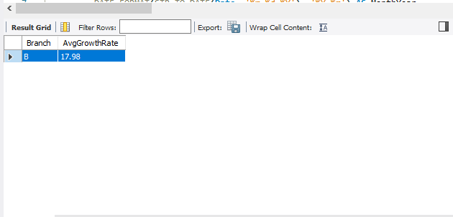
Result

Slide 4
Task 2: Finding the Most Profitable Product Line for Each Branch
Analysis:-
1 so create two CTE one for to calculate profit margin by branches and product line by difference between cog( cost of goods and gross margin)
2 creating CTE for Maximum profit margin by branches and product line
3 Then by self join these two table we can find maximum profit margin by product line by various branches

Slide 5
code
use final_project; select * from walmartsales; WITH ProductLineProfit AS ( SELECT Branch, product_line, SUM(cogs - gross_income) AS TotalProfit FROM walmartsales GROUP BY Branch, product_line),MaxProfitByBranch AS ( SELECT Branch, MAX(TotalProfit) AS MaxProfit FROM ProductLineProfit GROUP BY Branch)SELECT p.Branch, p.product_line AS ProductLineWithHighestProfit, p.TotalProfitFROM ProductLineProfit pJOIN MaxProfitByBranch m ON p.Branch = m.Branch AND p.TotalProfit = m.MaxProfitORDER BY p.Branch;

Slide 6
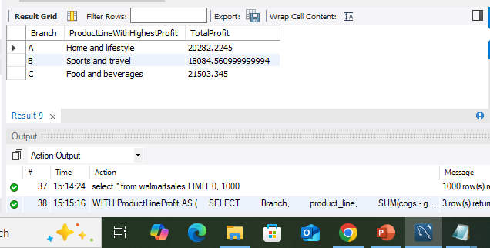
Result:-

Slide 7
Task 3: Analyzing Customer Segmentation Based on Spending
Code:-use final_project;select * from walmartsales; WITH CustomerSpending AS ( SELECT customer_Id, COUNT(Invoice_ID) AS TotalPurchases, SUM(Total) AS TotalSpending, AVG(Total) AS AvgSpending FROM walmartsales GROUP BY customer_Id),CustomerSegments AS ( SELECT customer_Id, AvgSpending, CASE WHEN AvgSpending >= (SELECT AVG(AvgSpending) + STDDEV(AvgSpending) FROM CustomerSpending) THEN 'High' WHEN AvgSpending >= (SELECT AVG(AvgSpending) FROM CustomerSpending) THEN 'Medium' ELSE 'Low' END AS SpendingTier FROM CustomerSpending)SELECT customer_Id, Round(AvgSpending) AS customer_spend, SpendingTierFROM CustomerSegmentsORDER BY customer_Id ASC;

Slide 8
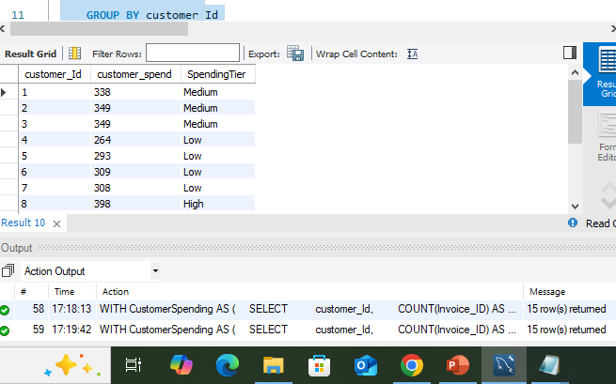
Result

Slide 9
Task 4: Detecting Anomalies in Sales Transactions
Analysis;-
1 create CTE for calculating average of sales
2 then create a another cte for comparing averge sales with total sales
3 self joining these two table with same productline give as a anomliese depend on sales value thus neglecting null value we get a records of customers having high and low sales values.

Slide 10
code
use final_project;select * from walmartsales;WITH ProductLineStats AS ( SELECT product_line, round(AVG(Total)) AS AvgSales FROM walmartsales GROUP BY product_line),Anomalies AS ( SELECT w.Customer_ID, w.Branch, w.product_line, w.Total, p.AvgSales, CASE WHEN w.Total < p.AvgSales THEN 'Low' WHEN w.Total > p.AvgSales THEN 'High' ELSE NULL END AS AnomalyType FROM walmartsales w JOIN ProductLineStats p ON w.product_line = p.product_line)SELECT *FROM AnomaliesWHERE AnomalyType IS NOT NULLORDER BY AnomalyType, product_line, Total DESC;

Slide 11
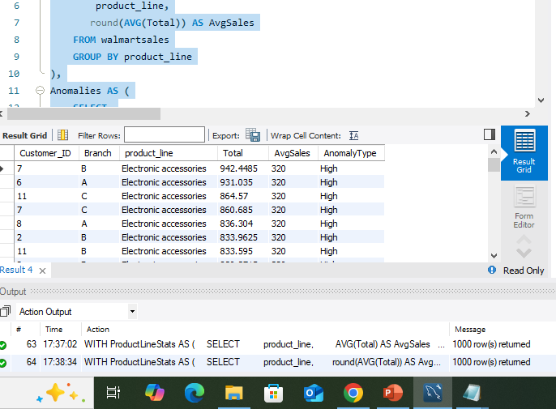
Result

Slide 12
Task 5: Most Popular Payment Method by City
Code:-
use final_project;select * from walmartsales;SELECT city, payment AS MostPopularPaymentMethod, COUNT(*) AS PaymentCountFROM walmartsalesGROUP BY city, paymentORDER BY city, PaymentCount DESC;

Slide 13
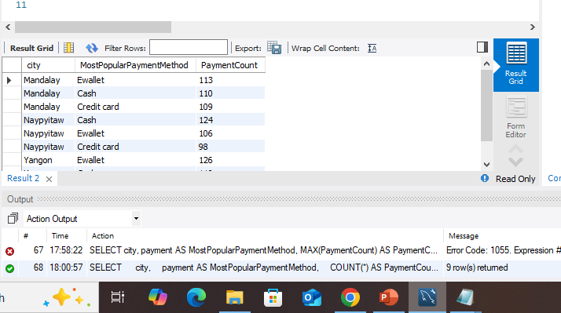
Result

Slide 14
Task 6: Monthly Sales Distribution by Gender
use final_project;select * from walmartsales;SELECT DATE_FORMAT(STR_TO_DATE(Date, '%m-%d-%Y'), '%Y-%m') AS MonthYear, Gender, round(SUM(Total)) AS TotalSalesFROM WalmartSalesgroup by gender;

Slide 15
Task 7: Best Product Line by Customer Type
Code:-
use final_project;select * from walmartsales;SELECT Customer_Type, Product_Line, COUNT(*) AS TotalPurchasesFROM WalmartSalesGROUP BY Customer_type, Product_lineORDER BY Customer_type, TotalPurchases DESC;v

Slide 16
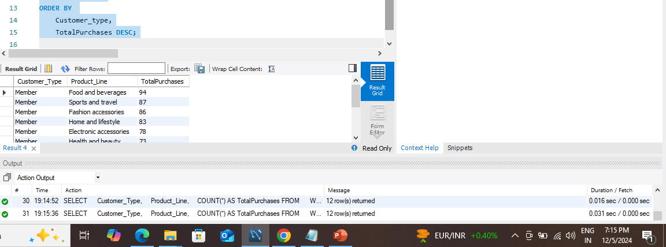
Result

Slide 17
Task 8: Identifying Repeat Customers
code:-
use final_project;select * from walmartsales;SELECT t1.customer_Id, t1.Invoice_ID AS FirstInvoiceID, t1.StandarddDate AS FirstPurchaseDate, t2.Invoice_ID AS RepeatInvoiceID, t2.StandarddDate AS RepeatPurchaseDate, DATEDIFF(t2.StandarddDate, t1.StandarddDate) AS DaysBetweenFROM walmartsales t1JOIN walmartsales t2 ON t1.customer_Id = t2.customer_Id AND t1.Invoice_ID <> t2.Invoice_ID AND DATEDIFF(t2.StandarddDate, t1.StandarddDate) BETWEEN 1 AND 30ORDER BY t1.customer_Id, t1.StandarddDate, t2.StandarddDate;

Slide 18
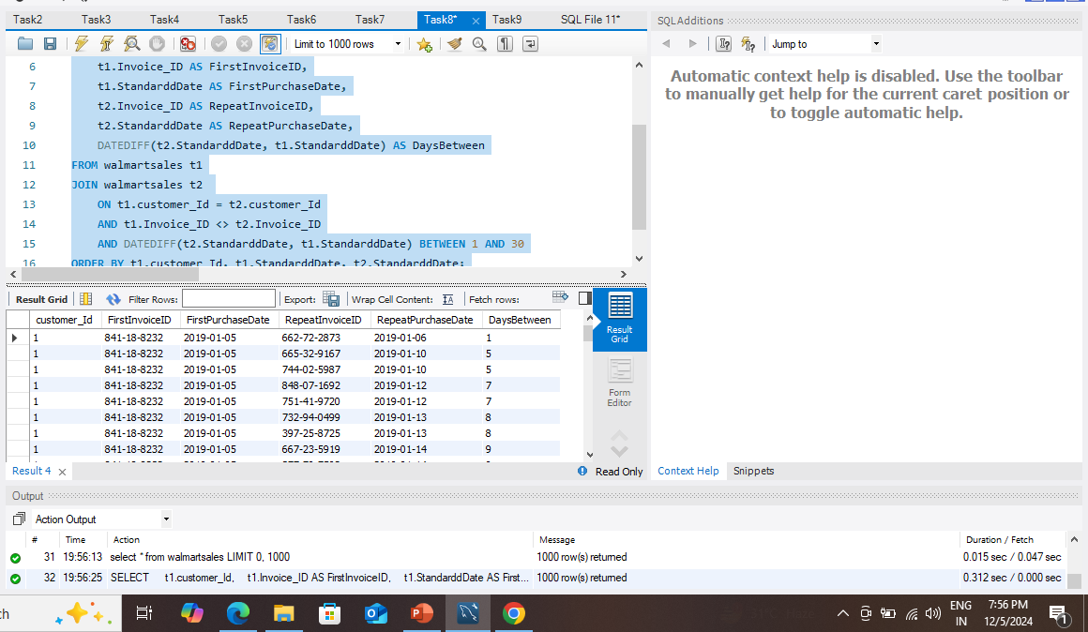
Result

Slide 19
Task 9: Finding Top 5 Customers by Sales Volume
Code:-
use final_project;select * from walmartsales;SELECT customer_Id, Round(SUM(Total)) AS TotalRevenueFROM walmartsalesGROUP BY customer_IdORDER BY TotalRevenue DESCLIMIT 5;

Slide 20
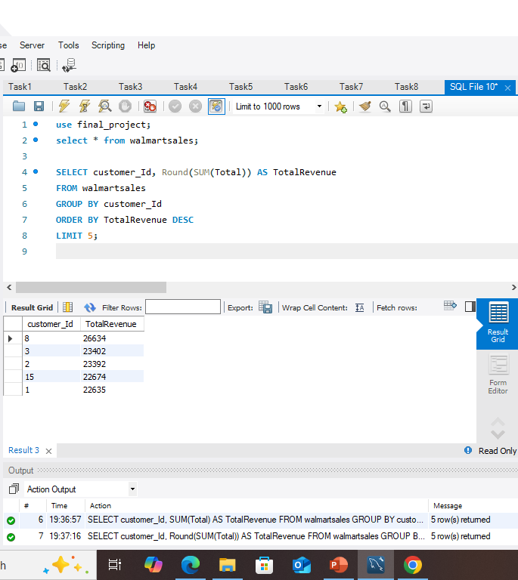
Result:-

Slide 21
Finding Top 5 Customers by Sales Volume

Slide 22
Task 10: Analyzing Sales Trends by Day of the Week
Code:-
use final_project;select * from walmartsales;SET SQL_SAFE_UPDATES = 0;ALTER TABLE walmartsales ADD StandarddDate DATE;UPDATE walmartsalesSET StandarddDate = CASE WHEN Date LIKE '%/%/%' THEN STR_TO_DATE(Date, '%d/%m/%Y') WHEN Date LIKE '%-%-%' THEN STR_TO_DATE(Date, '%d-%m-%Y') ELSE NULLEND;SELECT DAYNAME(StandarddDate) AS DayOfWeek, Round(SUM(Total)) AS TotalSalesFROM walmartsalesGROUP BY DayOfWeekORDER BY TotalSales DESC;

Slide 23
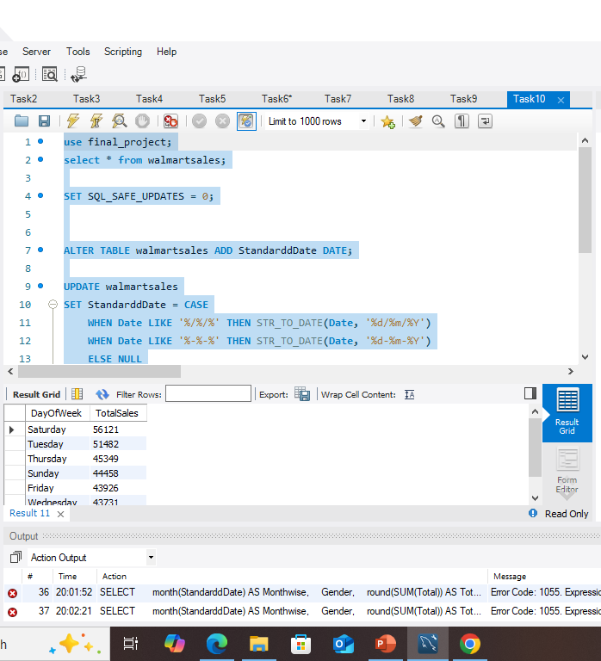
Result

Slide 24
Total sales by day of week

Slide 25
Video submission Link
https://drive.google.com/file/d/1CLbJg-z65__eBEel6CPZKq9WJ84nw8Op/view?usp=sharing
THANK YOU

